Slide 1

Aeolus Project – Status October 2012
Presentation to US WG on Space LIDARs
Presented by A. Culoma, ESA/ESTEC
Prepared by the Aeolus Project team in ESTEC
Boulder,16-18 October 2012

Slide 2
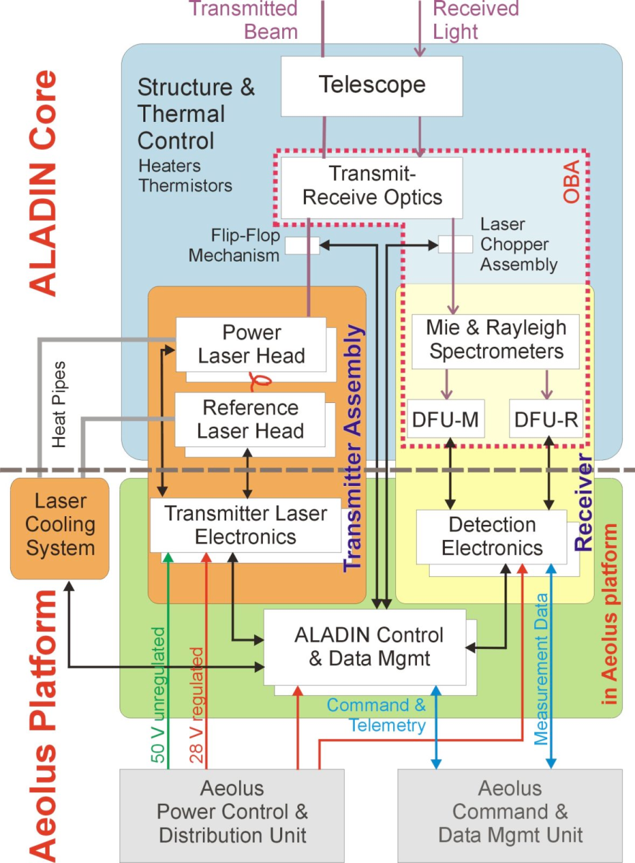
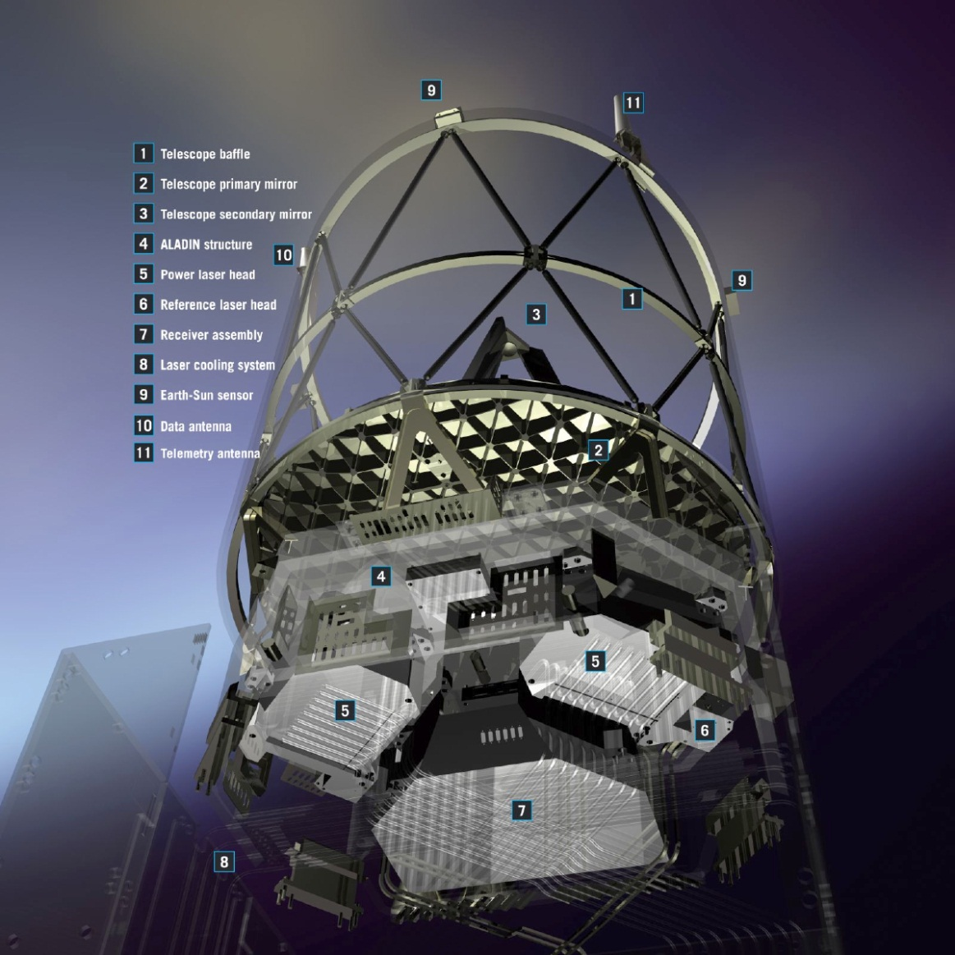
Satellite Items under Development
In-situ Cleaning
Application SW
Page 2

Slide 3
Summary of Status
Satellite: Ready for FM integration except the Aladin instrument and one panel of the platform where the In-Situ Cleaning System will be installed.
Platform: Central software is being updated to support the ICS and continuous mode operation of Aladin. Now delivered and under test on satellite test bench.
Aladin instrument: Work is ongoing on with the Transmit Laser Assembly (TXA) and integration of the sealed Transmit & Receive Optics (TRO). All three instrument electronic types (ACDM, DEU and TLE) have completed upgrade to support continuous mode operation. One of three laser electronics still to be completed.
Ground Segment: FOS (ESOC) and PGDS (ESRIN) developments completed and resources are kept in hibernation. End-to-end simulator, level 1B, 2A and 2B ground processors have been upgraded to support continuous mode operation.
Launcher: Preliminary Mission Analysis activities started for a baseline launch with VEGA (Verta2). Activities for a back-up opportunity on Rockot are on hold. VEGA qualification flight confirmed more severe shock environment requiring a shock test (VESTA) at satellite level and possibly delta-qualification unit level.
Page 3

Slide 4
Laser Transmitter
Development Status
Transmit Laser Electronic (TLE):
1^{st &} 2nd FMs re-qualified for continuous mode and ready for use;
3rd FM, anomaly discovered related to one of the amplifier drivers;
Power Laser Head (PLH):
FM-A: completed endurance tests in vacuum, inspected, characterized for +/-1G and used for fluence reduction verification;
FM-B: integration restarted after both optical amplifiers been de-integrated, repaired and re-integrated;
UV Optics:
Anti Reflective coatings from Laseroptik (AR4) found to have inadequate LIDT by refined screening technique recently in use at DLR. Alternative AR coating processes have not led to improvements, see more details later.
Effect of small imperfection spots on LIDT for High Reflective and Dichroic coatings from Laseroptik (HR4) are being investigated by test in ESTEC laser laboratory and DLR, see more details later.
Page 4

Slide 5
FM-A Endurance Test in Vacuum:
Objectives
To demonstrate that the TxA performances remain stable/controllable over 5 weeks of operation in near vacuum.
The test focused on three main aspects of the PLH instability:
UV output energy
Optical evolution of the MO and amplified beams
Laser Induced Contamination
To demonstrate compensation “procedures” over the instrument lifetime.
Page 5

Slide 6
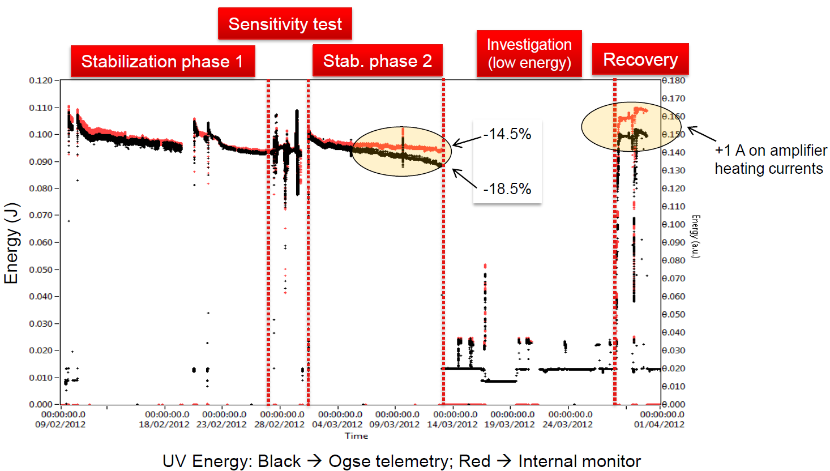
FM-A Endurance Test in Vacuum:
UV energy evolution
Page 6

Slide 7
FM-A Endurance Test in Vacuum:
Conclusions
Most objectives fully reached:
Laser Induced Contamination: has not been detected, oxygen partial pressure works fine
Beam stability in vacuum: very good results on vertical pointing (the most critical), good results on horizontal pointing (stabilization reached after 20 days)
The root cause of the UV energy reduction experienced in all previous vacuum test has been identified as divergence variation at the output of the amplifier section
Laser output energy can be controlled: procedure demonstrated by acting on the heating currents of the amplifiers
Three major Non-Conformance investigations are running:
Master oscillator bi-state characteristics
Amplifier temperature stabilization time (weeks or months)
UV optic damages
Page 7
Notes:
“investiagtion” to “investigations”

Slide 8
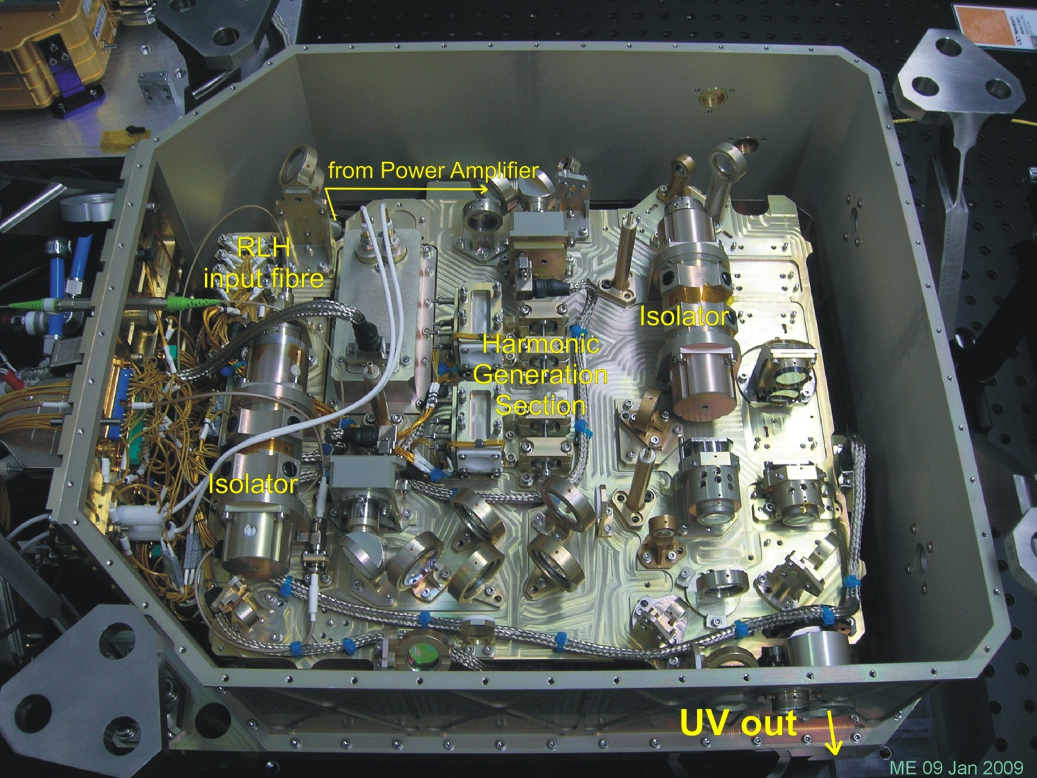
UV Optics Damages
Page 8

Slide 9
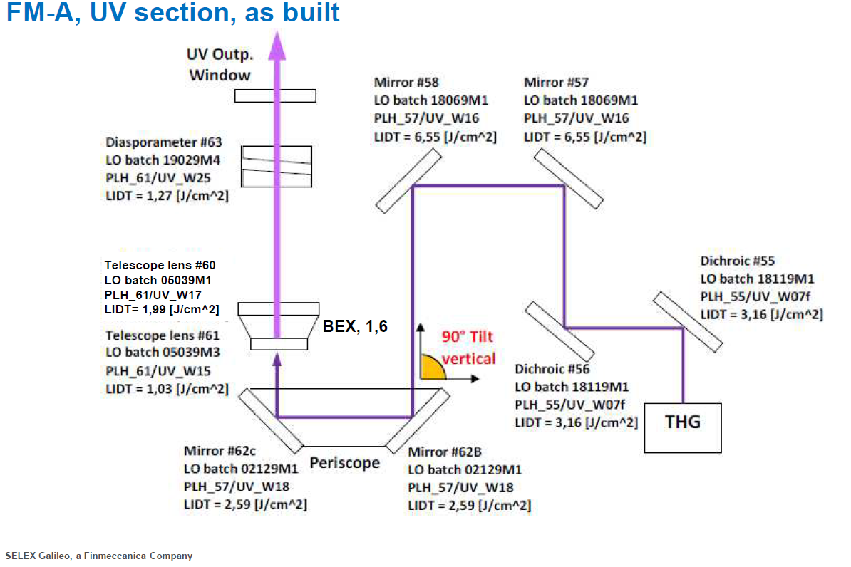
UV Optics Damages
SHG
Page 9

Slide 10
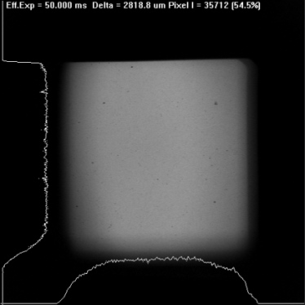
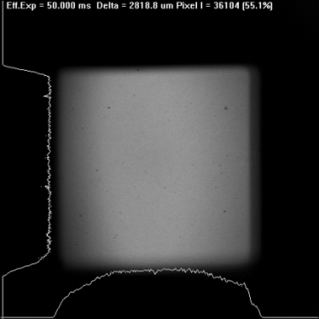
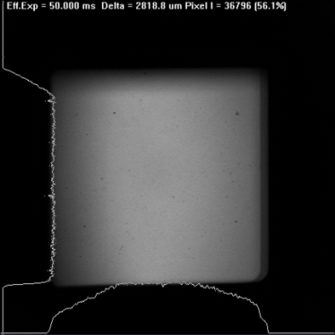
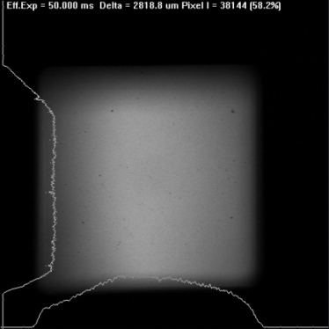
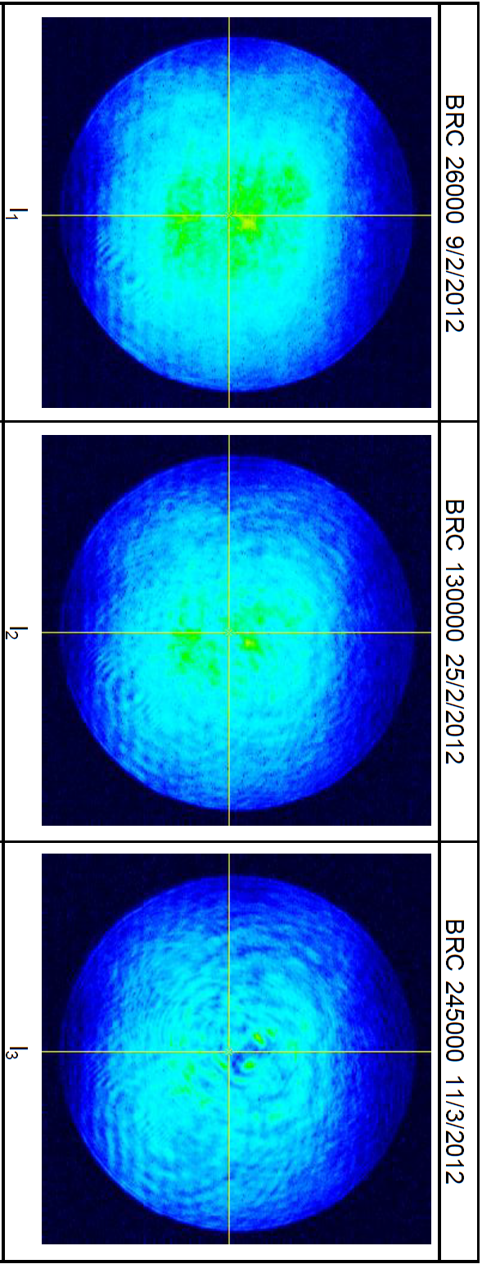
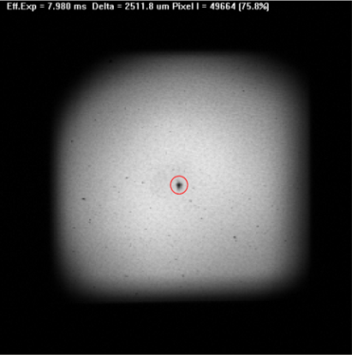
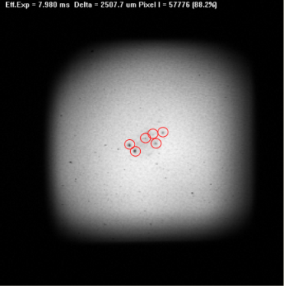
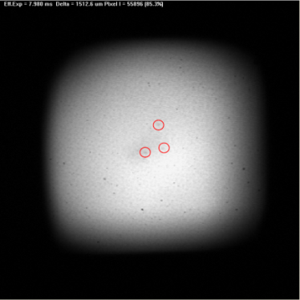
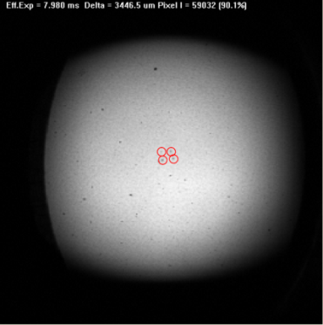
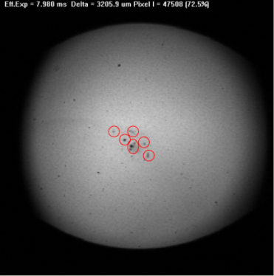
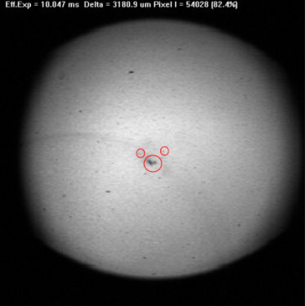
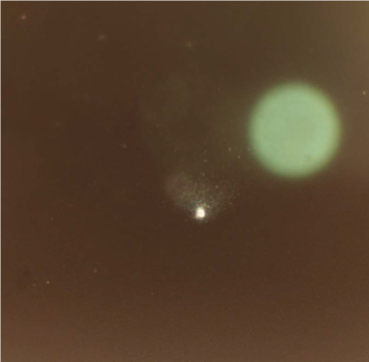
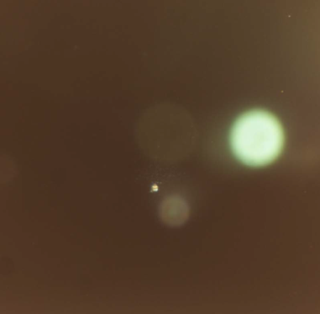
UV Optics Damages
SHG Input
SHG Output
THG Input
THG Output
Dichroic #1
Dichroic #2
Folding Mirror
Folding Mirror
Folding Mirror
Folding Mirror
BEx 1st lens input
BEx 1st lens output
Page 10

Slide 11
Road Map for UV Coating Remedial
Top level activities, all in parallel (ref:AE-TN-ESA-AL-056):
Root Cause Analysis
Top-down analysis
Bottom-up analysis
Increased LIDT by Alternative Substrates and Coatings
Alternative substrate suppliers
Condition substrates prior to coating
Alternative coating suppliers
Improved coating processes
Fluence Reduction Activities
Beam expansion prior to UV section
Energy reduction
New UV Optics Procurement
Page 11

Slide 12
Potential root causes for damage
Investigation of root-causes: top-down
Coated optics design change
Coated optics process change/deficiencies
LIDT measurement overestimates threshold
LIDT degrades with AIT of the assemblies
LIDT degrades with number of shots (fatigue)
LIDT degrades with time (aging)
Contamination lowers LIDT
In-situ cleaning @ 40Pa lowers LIDT
3 wavelengths combine to result in lower UV LIDT
High fluence event
Page 12

Slide 13
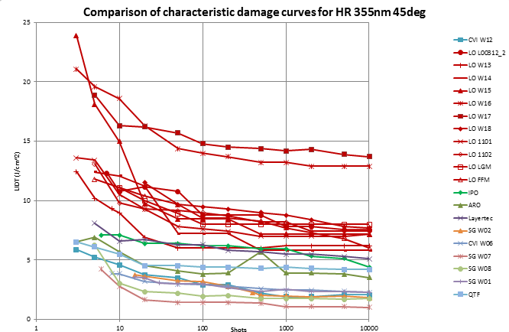
LIDT Values for UV Mirrors
Red curves: baseline supplier
Other colors: alternative suppliers
Page 13

Slide 14
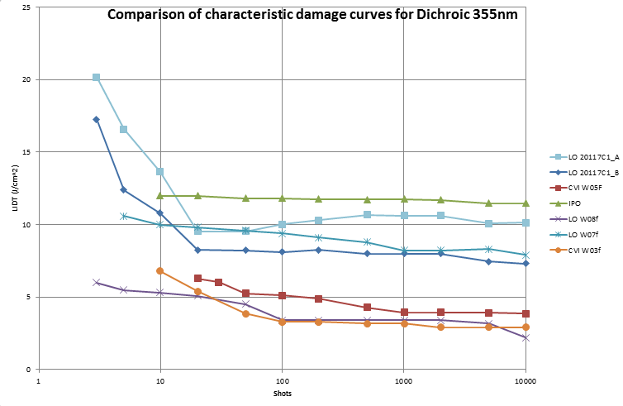
LIDT Values for 3λ−Dichroic in UV
Blue curves: baseline supplier
Other colors: alternative suppliers
Page 14

Slide 15
UV Lenses: refined screening at DLR
Requirement
TT rules
2009-2010
2012
Page 15

Slide 16
Potential root causes for damage
Investigation of root-causes: bottom-up
Detailed inspection of damage features
Detailed inspections of optics by Selex and ESTEC
All damage features are similar and small (ø50 – ø100 μm)
Evidence of very small precursors (ø1– ø3 μm)
Some surfaces still outstanding, e.g. harmonic section
Compare damage feature with LIDT test samples
Damage morphologies are different between LIDT samples and endurance test optics
LIDT sample damages are catastrophic (typically half the beam diameter) with no sign of small precursors
Identify potential damage precursors:
Surface contaminants on coating
Residual polishing contamination on substrates
Small defects caused by arcing during coating
Chemically label potential precursors
Surface contaminants are coming from residual epoxy outgassing
AR substrate “contamination” is Cerium-oxide from the polishing powder
HR coating damages contains stainless steel components (Fe, Ni, Cr …)
Eliminate precursors by cleaning and/or process change
Initial cleaning trials of surface contamination, effectiveness still to be verified
Initial cleaning trials of substrate contamination, effectiveness still to be verified
Coating samples using mechanical shutter and adjusted process parameters, samples available for test
Coating samples using improved arcing suppression techniques (less power, more sensitive supervisor), samples still to be produced
Verify performance:
Replication of damage on endurance test samples, on-going
LIDT test by DLR on above AR samples, still to be done
Modified LIDT test by DLR on new HR samples (raster scan), still to be done
Accelerated life test on above samples, still to be done
Page 16

Slide 17
Beam Expansion Prior to UV Section
Output energy: 110mJ
Fluence > LIDT
Fluence ~ LIDT
Fluence < LIDT
BEX 1,2
SHG*
Page 17
BEX 1,4

Slide 18
Energy Reduction
Output energy: 80mJ
Fluence > LIDT
Fluence ~ LIDT
Fluence < LIDT
BEX 1,2
SHG*
Page 18
BEX 1,4

Slide 19
Mission robustness vs performance
Aeolus being a demonstrator mission must find balance between mission robustness and mission performance;
FM-A endurance test has re-confirmed that fluence is a critical parameter to be carefully controlled;
The Project is committed to fulfill the mission requirements, however:
Take advantage of performance margins in the beginning of the mission and run the laser at lower output power;
Exploit the redundant laser as a real mission resource, i.e. include the redundant laser in the commissioning phase, use as a “fresh asset” whenever deemed necessary;
Given 2, explore the limits of the nominal laser by compensating mission degradations through increased laser power;
A beginning of life operational scenario with a 80 mJ laser is fully compatible with the performance predictions of 2 m/s random error;
An end of life scenario is either to increase the laser energy to ~100mJ, with the risk of damage and switch to redundant laser, or accepting a graceful performance degradation to ~2.5 m/s random error;
Page 19

Slide 20
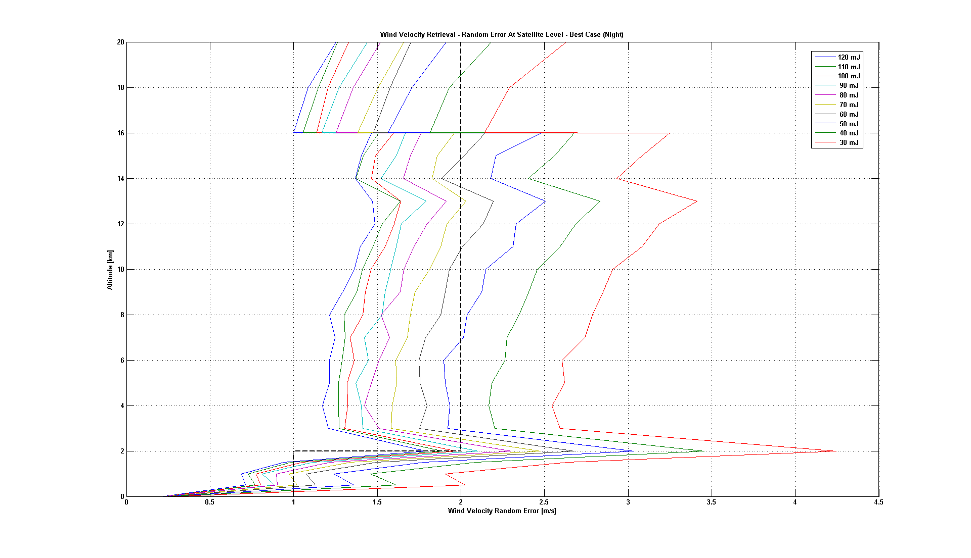
Random Error Predictions (BoL)
Page 20

Slide 21
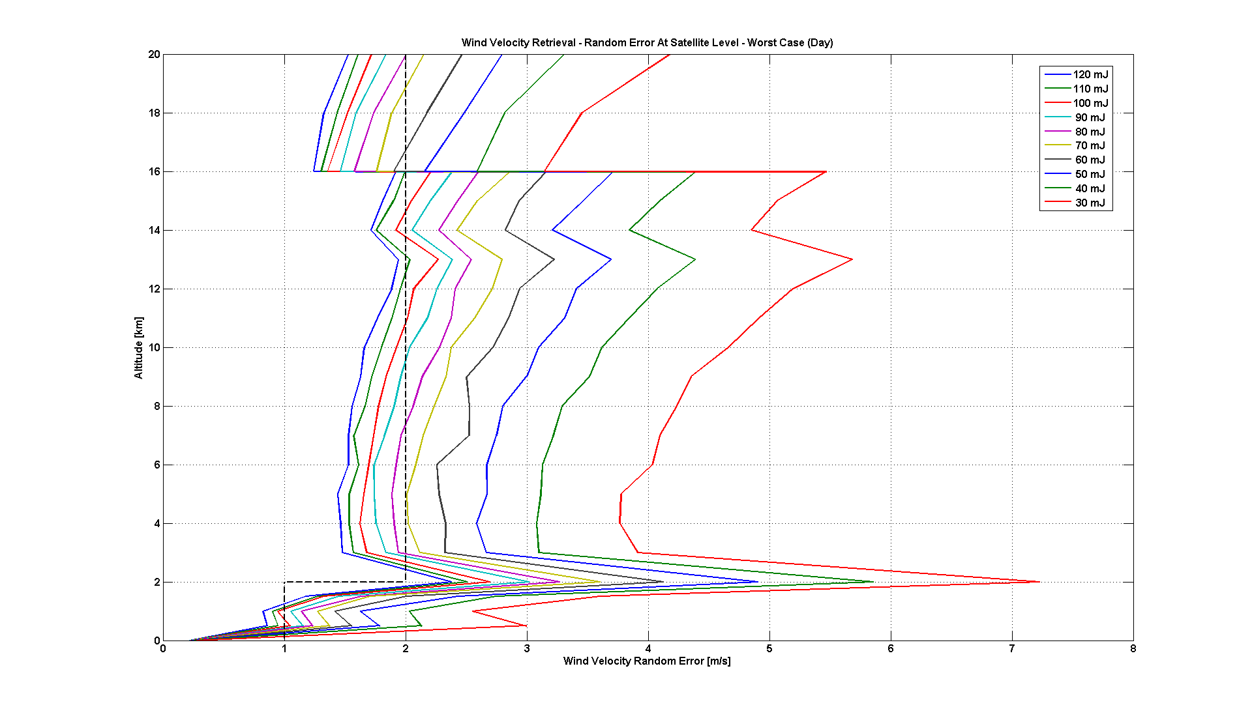
Random Error Predictions (EoL)
Page 21

Slide 22
Conclusions
The endurance test of the first flight laser successfully demonstrated many key performance parameters
However, small but unacceptable damages occurred on ~half of the UV optics
The Project and the Industrial team is working intensively on many fronts in parallel to confirm root causes and adequate solutions
As proven many times before, laser modifications are very time consuming (long lead times, re-alignment always starts from the MO, complex and long duration acceptance tests …)
The mission remains worldwide unique in its technological content and the user communities are still convinced that the mission products will bring break-through in weather forecast and climate research.
Page 22

